Slide 1
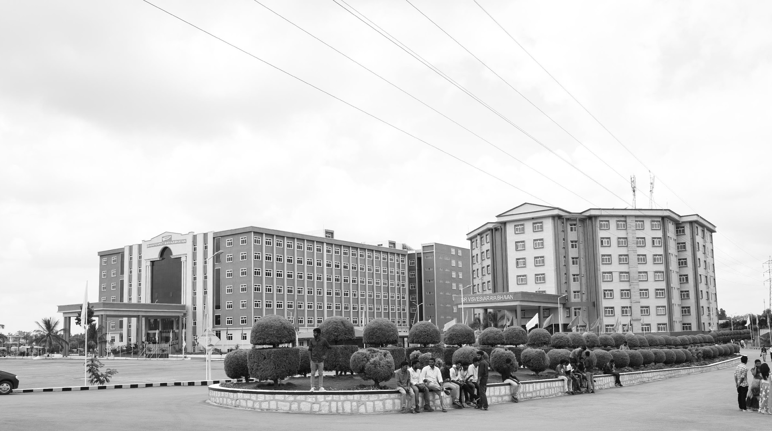

FUSING IMAGES FROM TWO MODES FOR HUMAN PERCEPTION
Mid-Review 3
Major Project
Project ID: CS14
AY 2021-25
GITAM (Deemed-to-be) University
Project Team:
Abhay Babu BU21EECE0100320
Sai Manjunath BU21EECE010442
Sai Krishna BU21EECE010320
Department of Electrical Electronics and Communication Engineering
Project Mentor:
Dr Koshy George
Project In-charge:
Dr Rohan Prasad
www.gitam.edu

Slide 2
Objective and Goals
Objective
This project aims to develop and evaluate image fusion techniques that seamlessly integrate the complementary features of visible-light and thermal images into a single, enhanced output. By exploring both conventional and machine learning-based methods, the goal is to preserve key details—such as texture, heat signatures, and contextual information—while ensuring high image quality, effective information retention, and computational efficiency. Emphasis will be placed on designing lightweight, real-time algorithms suitable for hardware implementation, with practical applications in fields like medical diagnostics, surveillance, and environmental monitoring.
Goals
Fusion in Multiple Color Spaces
Exhaustive Evaluation of Conventional Methods
Integration of Edge-Preserving Filters
Thermal-Visible Edge Overlay Fusion
Performance Analysis Across Methods
Real-Time Feasibility and Computational Efficiency
Comparative Study of Color Space Effects
Practical Application Validation

Slide 3
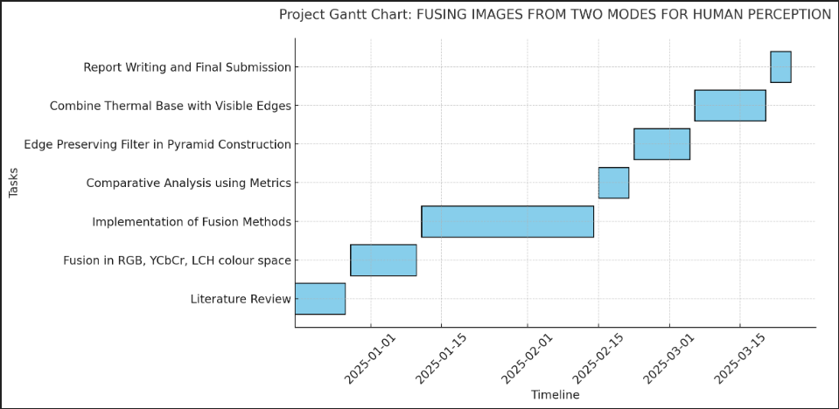
Project Plan (Clearly mention milestone for objectives under each reviews)
Gant Chart - Milestones and Activities

Slide 4
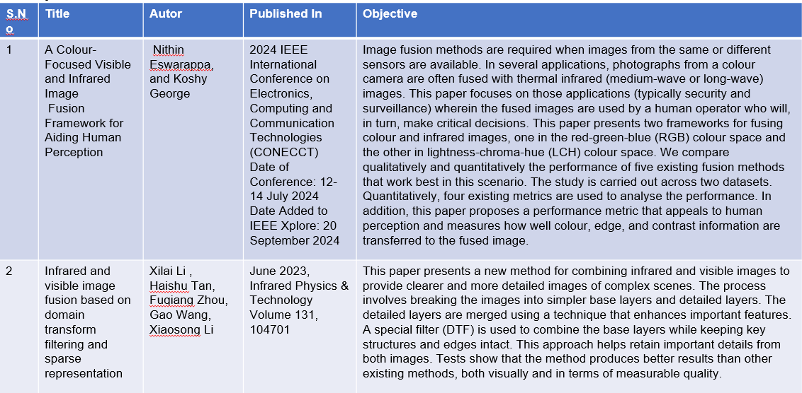
Literature Survey (Improved post minor project)
Key Publications

Slide 5
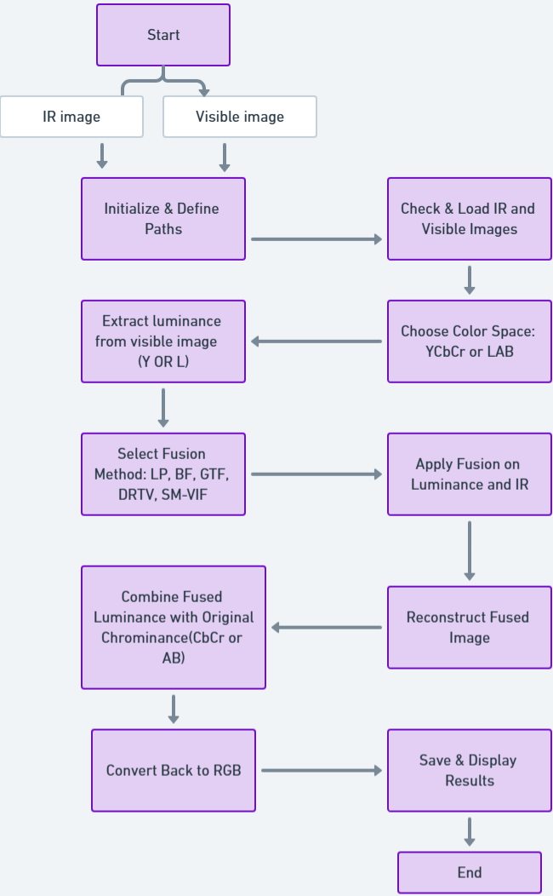
Architecture

Slide 6
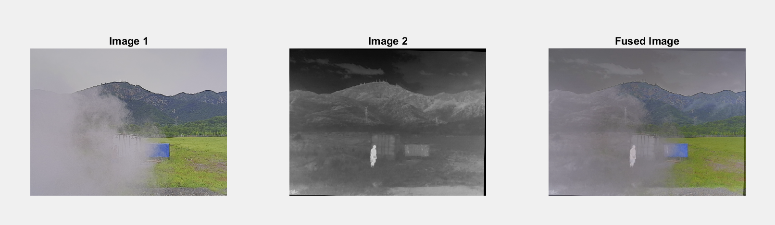
Implementation and Results – Iteration 1
Iteration 1 : Results
YCBCR IMPLEMENTATION AND RESULTS:-
YCbCr image fusion leverages the luminance (Y) and chrominance (Cb, Cr) components to effectively combine complementary features from multiple images. By fusing the Y channel, which contains intensity information, and preserving the Cb and Cr channels for color, the method ensures better visual clarity and detail retention. This approach minimizes color distortion and enhances the structural and contextual details in the fused output. It is particularly useful in applications like surveillance and low-light imaging, where preserving both brightness and color fidelity is critical.

Slide 7
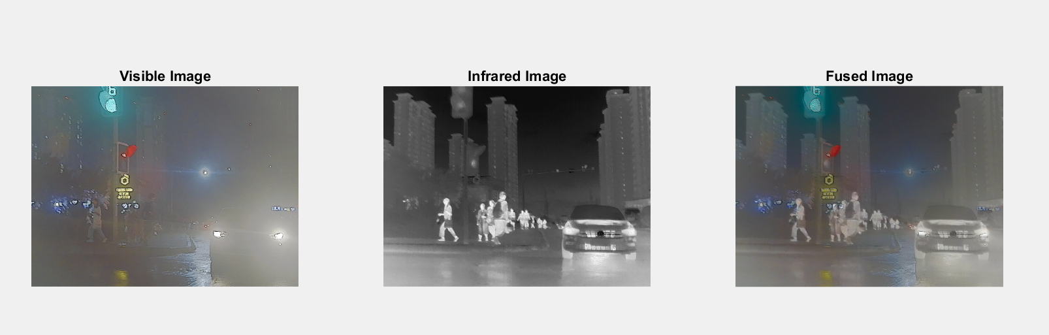
Implementation and Results – Iteration 2
LCH implementation and result:-
LCH image fusion operates in the Luminance (L), Chroma (C), and Hue (H) color space, enabling the separation of intensity and color information for more effective fusion. By fusing the L channel, which holds brightness details, while maintaining the C and H channels for color integrity, this method enhances both structural and color accuracy in the output. LCH fusion provides better contrast and visual clarity, making it ideal for applications where color perception and fine detail are critical, such as medical imaging and environmental monitoring.

Slide 8
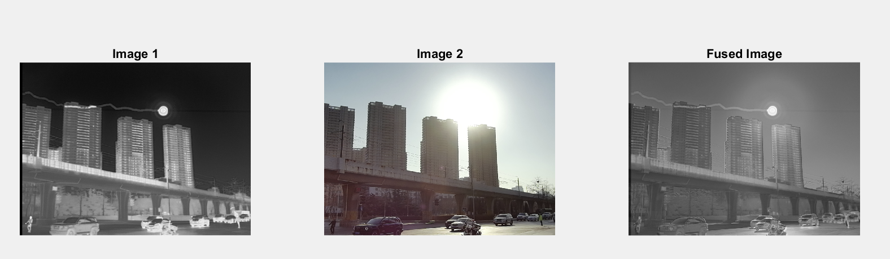
Implementation and Results – Iteration 3 (Optional)
LAB implementation and results:-
Lab image fusion uses the CIE Lab color space, which separates an image into Lightness (L) and color components (a and b) for more precise processing. The L channel, representing brightness, is typically fused to enhance structural details, while the a and b channels retain color fidelity. This method ensures better contrast, detail preservation, and minimal color distortion in the fused output. Lab image fusion is widely used in applications like remote sensing, medical diagnostics, and surveillance, where both clarity and accurate color representation are crucial.

Slide 9
Implementation of Image fusion method in YCBCR Color Space
Fusion methods
Laplacian pyramid fusion(LP Fusion)
Bayesian fusion(BF Fusion).
Gradient Transfer fusion (GTF fusion).
Deep Residual Transfer-based Vision (DRTV FUSION).
Saliency-Based Multiscale and Visible Image Fusion (SM-VIF).
Laplacian Pyramid Fusion (LP)
Laplacian Pyramid Fusion (LP) is a multi-scale approach that decomposes images into different frequency bands using a Laplacian pyramid. The fusion process is applied at each level of the pyramid by selecting the most relevant details from both images. The fused image is then reconstructed by summing the pyramid levels. This method is effective in preserving edges and fine details while reducing redundancy in fused images. It is commonly used in multi-focus and medical imaging applications. However, it may introduce slight blurring if not handled properly.
Key Advantage: Good edge preservation.
Best For: Multi-focus image fusion.

Slide 10
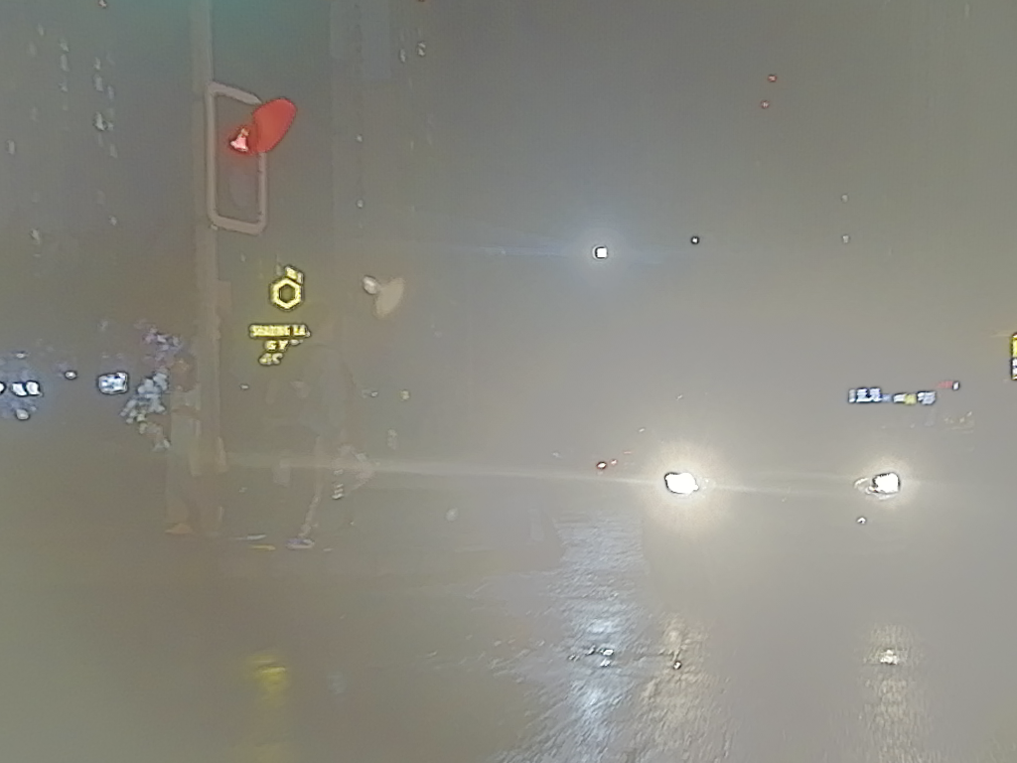
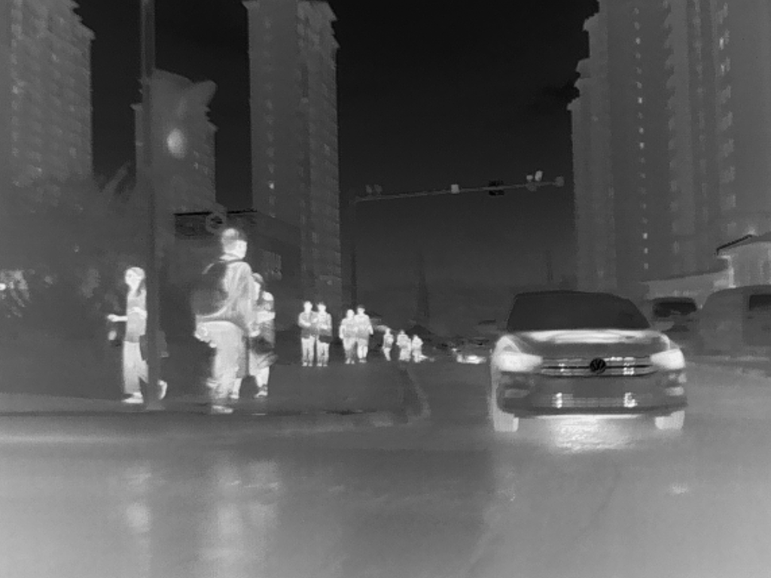
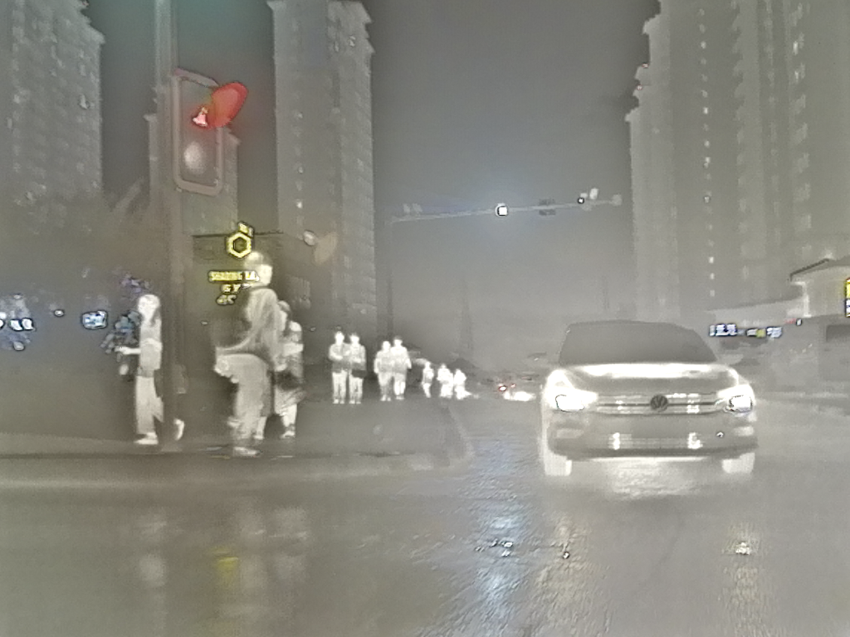

Slide 11
Bayesian Fusion (BF)
Bayesian Fusion is a probabilistic method that combines multiple images using Bayes' theorem, ensuring optimal information retention. It considers prior knowledge and sensor reliability to estimate the most probable fused image. This approach enhances clarity while reducing noise, making it ideal for medical imaging, surveillance, and infrared-visible fusion. By leveraging statistical inference, it effectively balances details from different sources. This ensures the fused image retains both structural accuracy and meaningful contrasts for better human perception.
Future Work

Slide 12
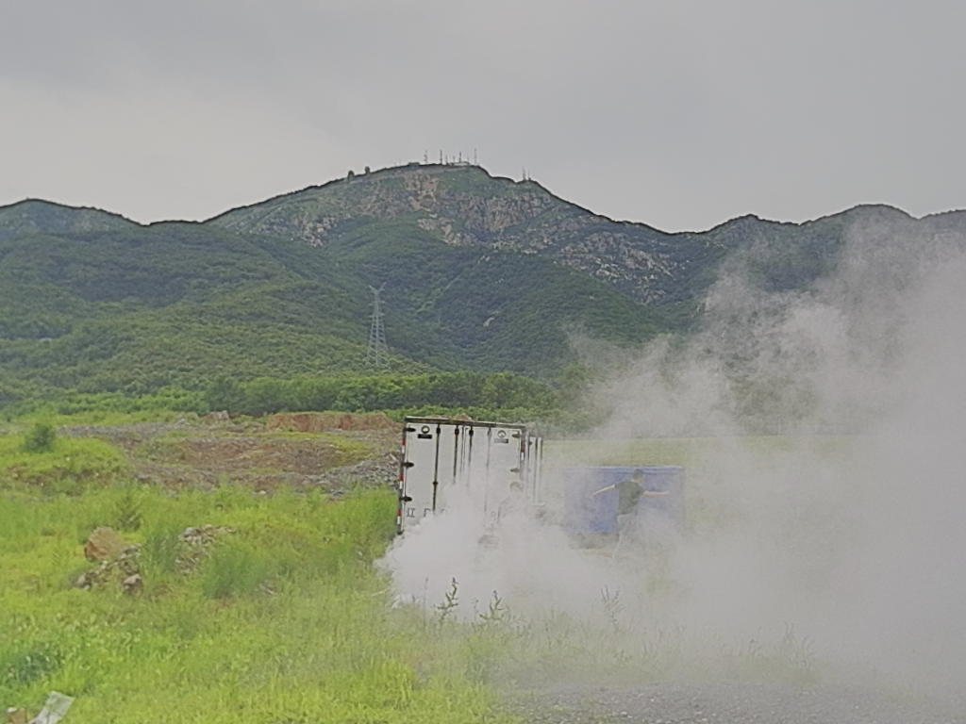
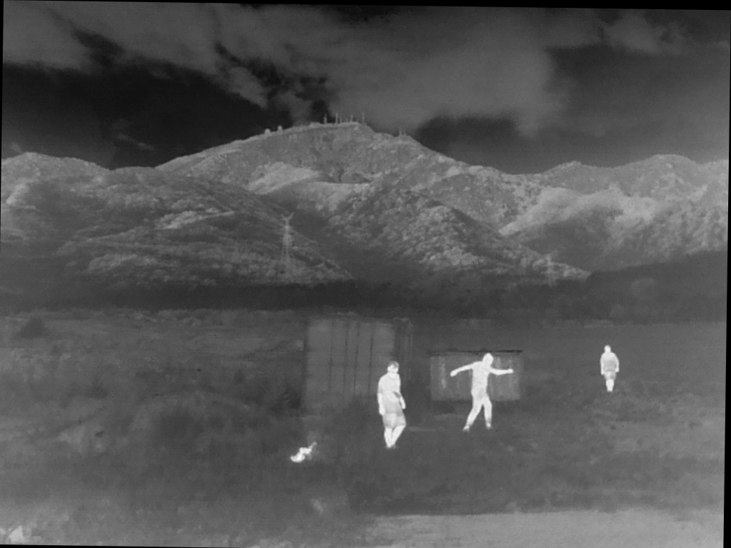
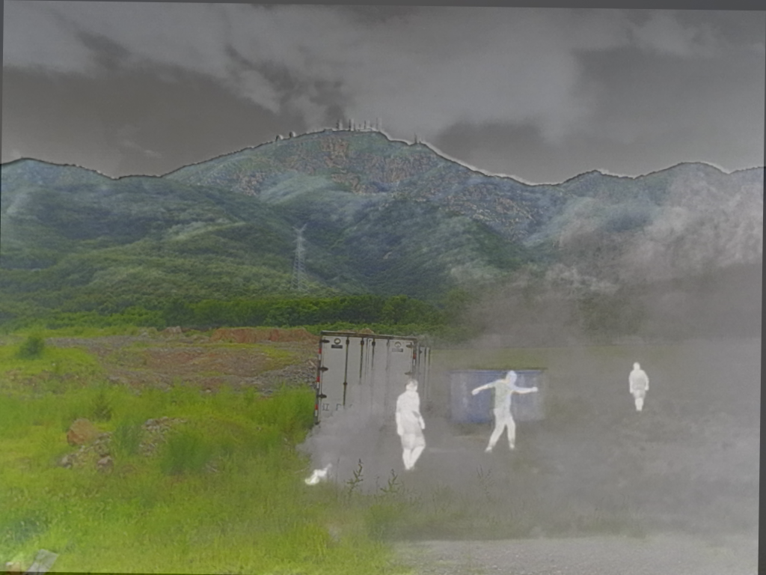

Slide 13
Gradient Transfer Fusion (GTF) Fusion
Gradient Transfer Fusion (GTF) is an image fusion technique that enhances edge details by transferring gradient information from source images to the fused image. It preserves fine structures by ensuring that high-gradient regions, such as edges and textures, are effectively combined. GTF minimizes blurring and loss of detail, making it well-suited for infrared-visible fusion, medical imaging, and surveillance applications. By focusing on gradient consistency, it ensures that the fused image retains sharp transitions and improved visual clarity while maintaining important scene details.

Slide 14
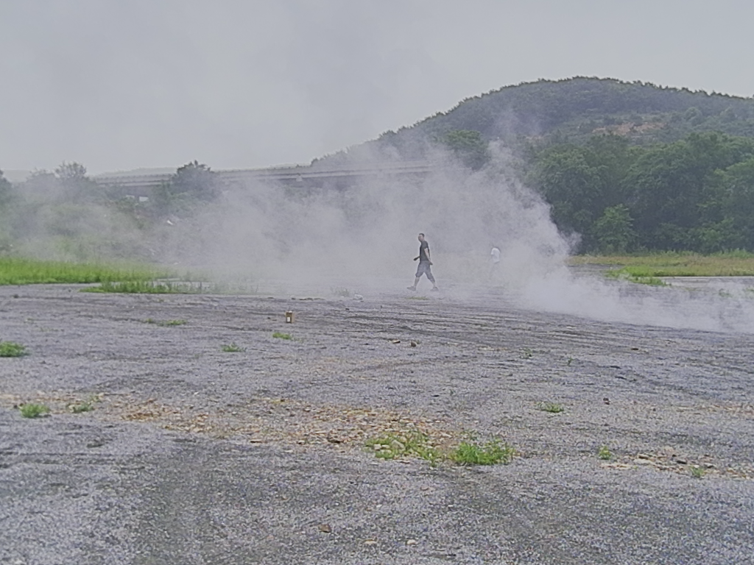
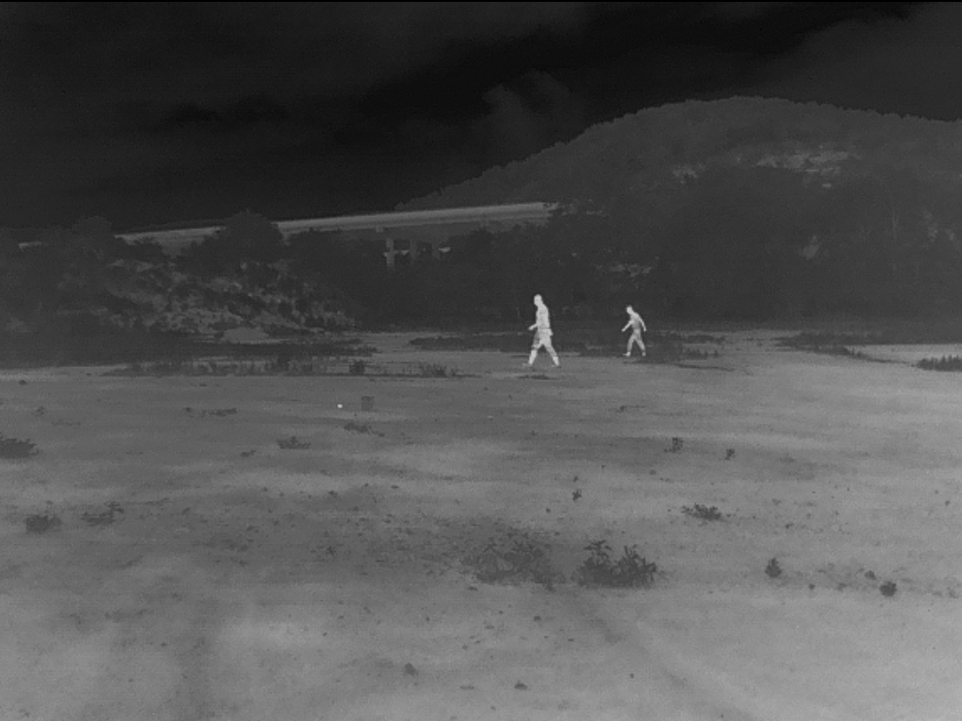
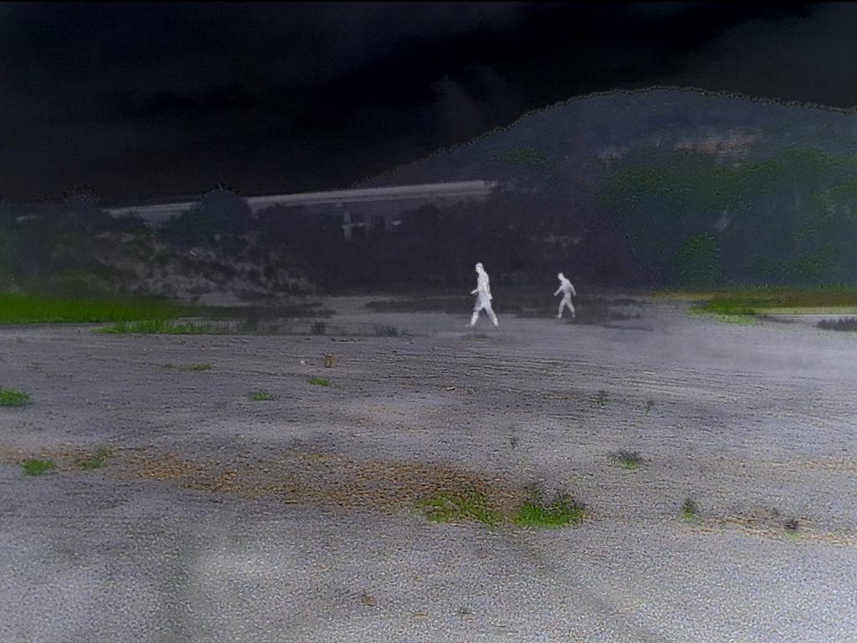

Slide 15
Deep Residual Transfer-based Vision (DRTV) Fusion
Deep Residual Transfer-based Vision (DRTV) Fusion is a deep learning-based technique that enhances image fusion by leveraging residual learning and transfer learning. It uses pre-trained deep networks to extract multi-scale features and residual connections to preserve fine details. This method ensures that essential textures and edges are retained while reducing noise and artifacts. DRTV fusion is highly effective in infrared-visible fusion, medical imaging, and autonomous vision systems, where high-detail preservation is crucial. By integrating deep learning models, it produces high-quality, perceptually enhanced fused images with improved clarity and feature consistency

Slide 16
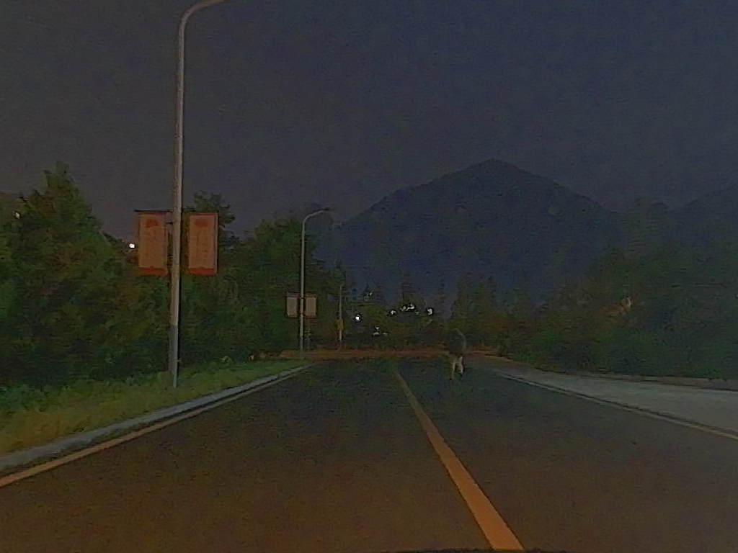
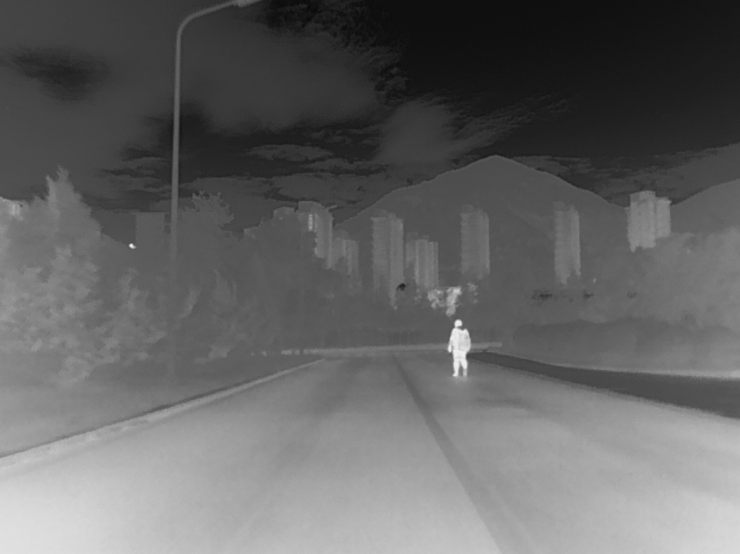
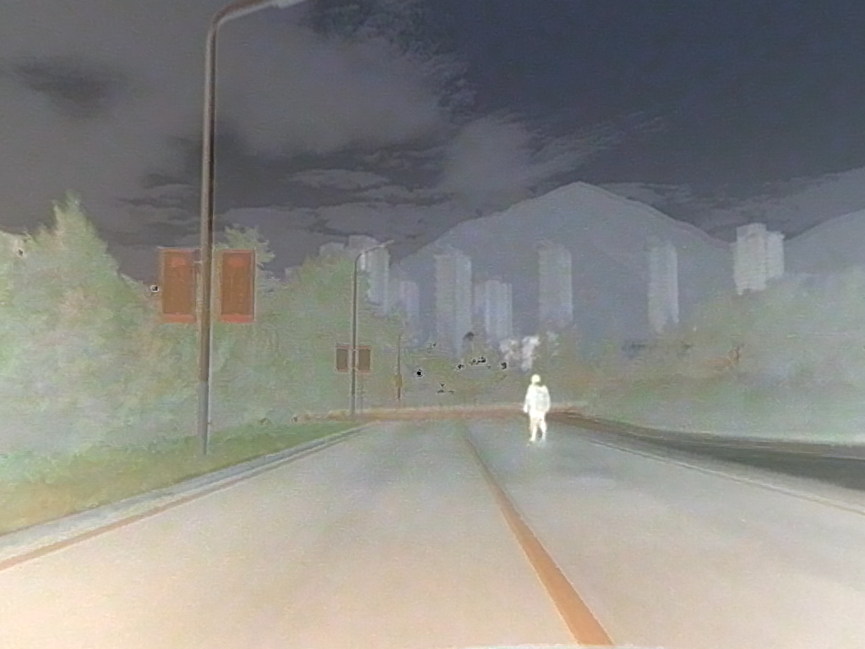

Slide 17
Saliency-Based Multiscale and Visible Image Fusion (SM-VIF)
Saliency-Based Multiscale and Visible Image Fusion (SM-VIF) is an image fusion technique that enhances visually important regions by integrating saliency detection with multiscale decomposition. It identifies key features in both input images and adaptively assigns higher weights to salient regions during fusion. This ensures that the fused image retains sharp details, strong textures, and minimal background noise. SM-VIF is highly effective in infrared-visible fusion, medical imaging, and surveillance, where highlighting critical features is essential. By combining saliency and multiscale processing, it produces high-contrast, information-rich fused images for better human perception.

Slide 18
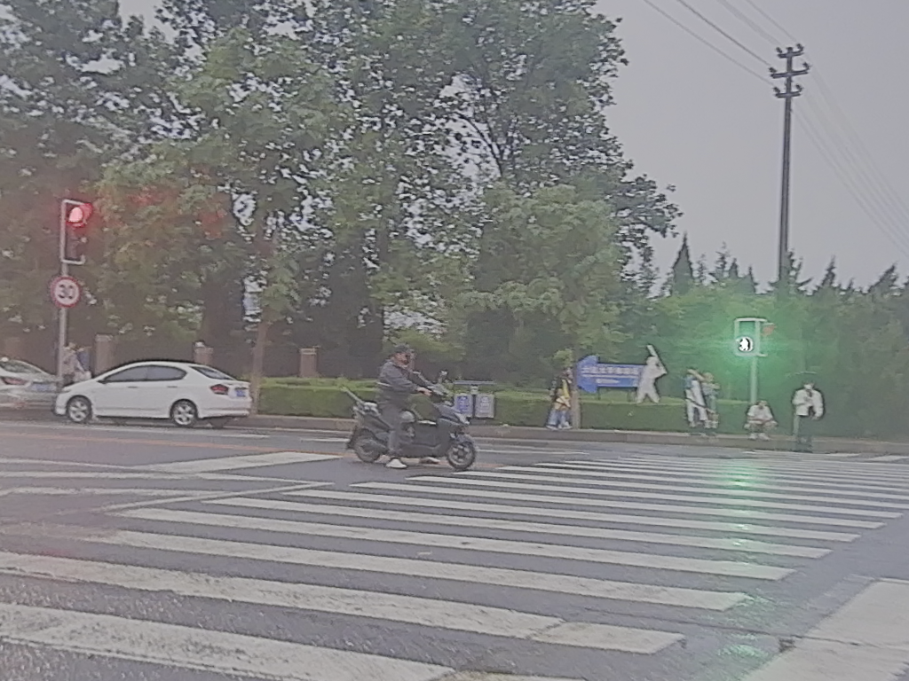
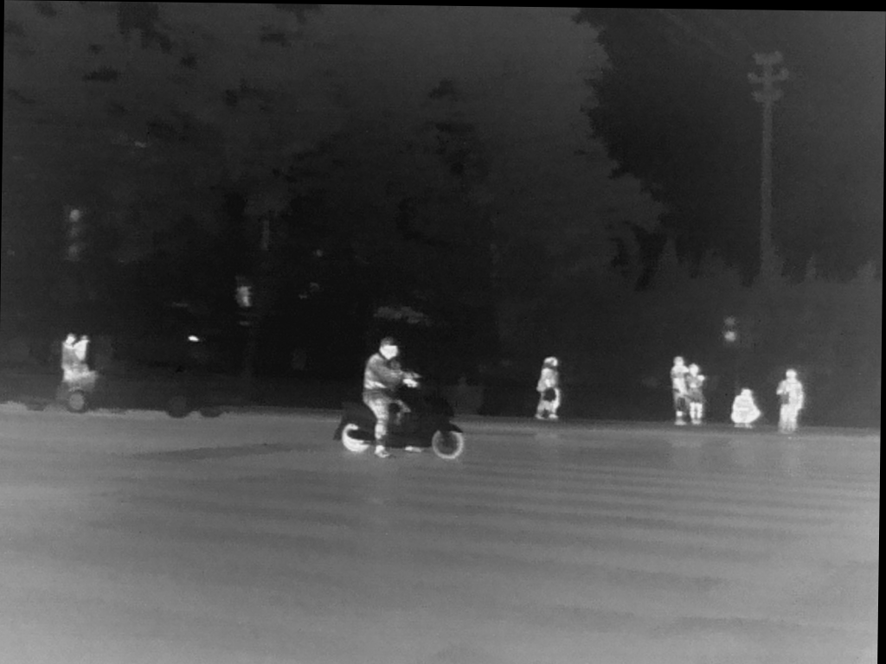
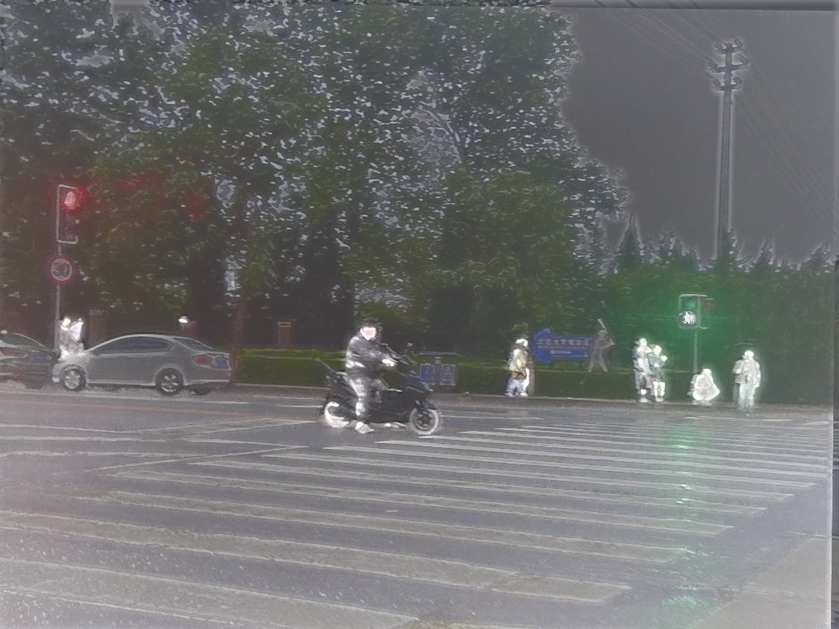
Conclusion & Future Work

Slide 19
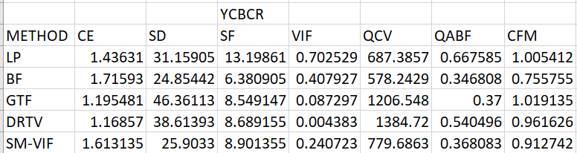
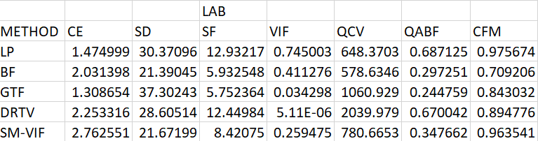
Performance metrics

Slide 20
CONCLUSION
In this project, we implemented and analyzed five image fusion methods—Laplacian Pyramid (LP), Bayesian Fusion (BF), Gradient Transfer Fusion (GTF), Deep Residual Transfer-based Vision (DRTV), and Saliency-Based Multiscale Visible Image Fusion (SM-VIF)—across two datasets (M3FD and LLVIP) using two color spaces (YCbCr and LAB). The evaluation was conducted using multiple objective quality metrics, including CE (Contrast Entropy), SD (Standard Deviation), SF (Spatial Frequency), VIF (Visual Information Fidelity), QCV (Quality of Color Visualization), QABF (Quality Assessment Based on Feature), and CFM (Color Fusion Metric).
The results indicate that different fusion methods perform optimally under different conditions. GTF and LP methods showed higher contrast entropy and spatial frequency, highlighting their ability to preserve sharp details and edges effectively. DRTV and SM-VIF exhibited improved performance in terms of color fidelity and structure preservation, as reflected in the QCV and CFM scores. Meanwhile, BF performed well in maintaining balanced fusion but exhibited lower values in some sharpness-related metrics.
Between the two color spaces, YCbCr generally preserved color integrity better, while LAB showed higher standard deviation and entropy, suggesting better contrast enhancement. The choice of method and color space depends on the specific application requirements, such as detail preservation, noise reduction, or color consistency.
Overall, this study demonstrates the strengths and trade-offs of different fusion techniques, providing insights into selecting optimal fusion strategies for infrared-visible fusion, medical imaging, and surveillance applications. Future work could explore deep learning-based adaptive fusion strategies to further enhance performance across various datasets and environments.

Slide 21
THANK YOU
Have a Great Day !

